Slide 1
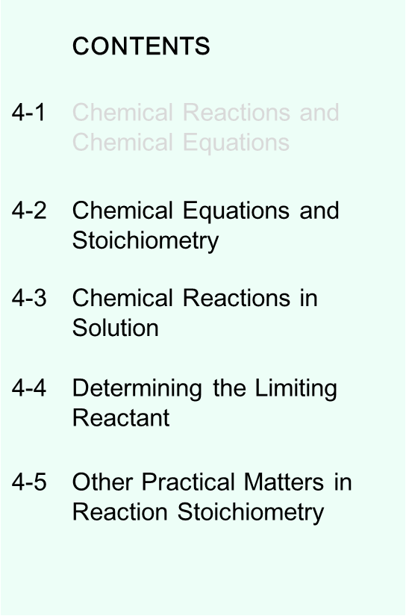
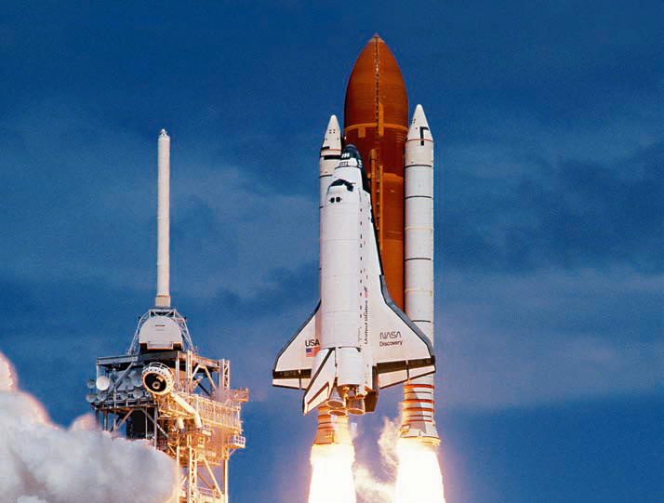
Chemical Reactions
Slide <number> of 24
General Chemistry: Chapter 3
Copyright © 2011 Pearson Canada Inc.
Notes:
Chemistry 140 Fall 2002

Slide 2
Balancing Equations
C₆H₁₄O₄ + O₂ → CO₂ + H₂O
C 6 → 1
H 14 → 2
O 4 + 2 → 2 1
Slide <number> of 24
General Chemistry: Chapter 4
Copyright © 2011 Pearson Canada Inc.
Notes:
Chemistry 140 Fall 2002

Slide 3
Balancing Equations
C₆H₁₄O₄ + O₂ → CO₂ + H₂O
15/2
6
7
C 6 → 1
H 14 → 2
O 4 + 2 → 2 1
x6
x7
x6
x7
4 + 15
19 O atoms
2 C₆H₁₄O₄ + 15 O₂ → 12 CO₂ + 14 H₂O
General Chemistry: Chapter 4
Copyright © 2011 Pearson Canada Inc.
Notes:
Chemistry 140 Fall 2002

Slide 4
Balancing Equations: Other information
Δ
heat
2 C₆H₁₄O₄ (l) + 15 O₂ (g) → 12 CO₂ (g) + 14 H₂O (l)
States of matter
Reaction conditions: temperature, pressure, catalysts, ect
Slide <number> of 24
General Chemistry: Chapter 4
Copyright © 2011 Pearson Canada Inc.
Notes:
Chemistry 140 Fall 2002

Slide 5
Balancing Equations → Stoichiometry
2 C₆H₁₄O₄ (l) + 15 O₂ (g) → 12 CO₂ (g) + 14 H₂O (l)
2 molecules of C₆H₁₄O₄ produce 12 molecules of CO₂
2x molecules of C₆H₁₄O₄ produce 12x molecules of CO₂
2N_{A} molecules of C₆H₁₄O₄ produce 12N_{A} molecules of CO₂
2 moles of C₆H₁₄O₄ produce 12 moles of CO₂
The conversion ratio is:
2moles of C₆H₁₄O₄ /12 moles of CO₂
Mole ratio or
Stoichiometric factor
2 moles of C₆H₁₄O₄ produce 14 moles of H₂O
14 moles of H₂O are produced for every 15 moles of O₂ consumed
15 moles of O₂ are needed to react with 2 moles of C₆H₁₄O₄
Notes:
Chemistry 140 Fall 2002

Slide 6
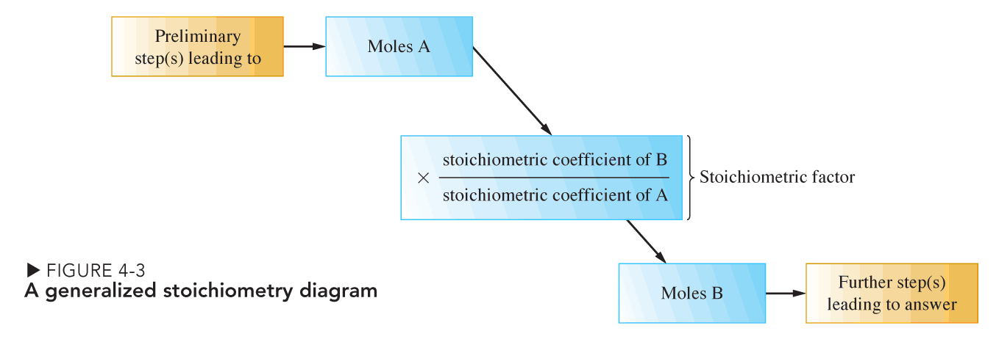
Solving Stoichiometry Problems
Slide <number> of 24
General Chemistry: Chapter 3
Copyright © 2011 Pearson Canada Inc.
Notes:
Chemistry 140 Fall 2002

Slide 7
Example
Molar mass C₆H₁₄O₄ = 150.2 g/mol
Molar mass of CO₂ = 44.01 g/mol
What mass of CO₂ is formed in the reaction of 4.16 g of C₆H₁₄O₄ with an excess of O₂?
2 C₆H₁₄O₄ (l) + 15 O₂ (g) → 12 CO₂ (g) + 14 H₂O (l)
4.16 g excess ?? g
1. How many moles of C₆H₁₄O₄
2. How many moles of CO₂
Use stoichiometric factor
3. How many grams of CO₂
Notes:
Chemistry 140 Fall 2002

Slide 8
Chemical Reactions in Solution
Solutions provide close contact between atoms, ions and molecules necessary for a reaction to occur.
Reactions often take place in solution
Solvent
  We will usually use aqueous (aq) solution.
Solute
  A material dissolved by the solvent.
Need to relate the amount of solute in the solution to numbers of moles
Notes:
Chemistry 140 Fall 2002

Slide 9
Concentration: Molarity
Amount of solute (mol solute)
Molarity (M) =
Volume of solution (L)
n
M =
moles of solute
L of solution
V
If 0.440 mol of urea is dissolved in enough water to make 1.000 L of solution the concentration is:
0.440 mol urea
M_{urea} =
= 0.440 M CO(NH₂)₂
1.000 L
“0.440 molar”
General Chemistry: Chapter 4
Copyright © 2011 Pearson Canada Inc.
Notes:
Chemistry 140 Fall 2002

Slide 10
Calculating Molarity
What is the Molarity of a solution of 25.0 mL of ethanol (d = 0.789 g/mL) in enough water to make 250.0 mL of solution
How many moles of ethanol in 25.0 mL?
General Chemistry: Chapter 4
Copyright © 2011 Pearson Canada Inc.
Notes:
Chemistry 140 Fall 2002

Slide 11
Dilution: Need to prepare solutions of different concentrations from a “stock solution”
Take 10 mL of a solution that is 1.71M and dilute it to a volume of 100 mL. What is the concentration (Molarity) of the new solution?
“There are 1.71 moles in 1 L of solution”
In 10 mL there are: 0.010L x 1.71mol/1L = 0.0171moles
n = V₁ x M₁
In the 100 mL of the new solution there are also 0.0171 moles
n/ V₂ = M₂
n = V₂ x M₂
The Molarity of the new solution (M₂) is: 0.0171 moles/L = 0.0171M
V₁ x M₁ = V₂ x M₂
Notes:
Chemistry 140 Fall 2002

Slide 12
Dilution
A 15.0 mL sample of 0.450M K₂CrO₄ is diluted to 100.0mL
What is the concentration (M) of the new solution?
15.0 mL of 0.450M K₂CrO₄ has ?? moles
V₁ M₁
How many moles do we have in the 15.0 mL?
M of the new solution (M₂) = # of moles divided by the new Volume (V₂) in L
Alternatively: M₁V₁ = M₂V₂
Notes:
Chemistry 140 Fall 2002

Slide 13
Stoichiometry of Reactions in Solution
A 25.00 mL sample of 0.250 M K₂CrO₄ is added to excess AgNO₃ (aq).
What mass of Ag₂CrO₄ is formed?
K₂CrO₄ (aq) + 2 AgNO₃ (aq) → Ag₂CrO₄ (s) + 2 KNO₃ (aq)
2.00 mL of excess ?? g
0.250M
1. How many moles of K₂CrO₄
2. Stoichiometric ratio?

Slide 14
A 25.00 mL sample of 0.250 M K₂CrO₄ is added to excess AgNO₃ (aq).
What mass of Ag₂CrO₄ is formed?
K₂CrO₄ (aq) + 2 AgNO₃ (aq) → Ag₂CrO₄ (s) + 2 KNO₃ (aq)
2.00 mL of excess ?? g
0.250M
4. How many moles of Ag₂CrO₄ are formed?
Molar mass of Ag₂CrO₄ = 331.73 g
5. How many grams Ag₂CrO₄ are formed?

Slide 15
What is a ‘Limiting Reagent’
P₄ (s) + Cl₂(g) → PCl₃ (l)
1. Balance
P 4 1
Cl 2 3
2. Stoichiometric factors:
Notes:
Chemistry 140 Fall 2002

Slide 16
Limiting Reagent
What is the maximum amount of PCl₃ that can be obtained from 125 g of P₄ and 323 g Cl₂?
P₄ (s) + 6 Cl₂(g) → 4 PCl₃ (l)
125 g 323 g ?? g
1. How many moles of each reactant to we have?
2. What is the stoichiometric factor for this reaction?
3. Which is the Limiting Reactant?
Notes:
Chemistry 140 Fall 2002

Slide 17
Limiting Reagent
P₄ (s) + 6 Cl₂(g) → 4 PCl₃ (l)
What is the maximum amount of PCl₃ that can be obtained from 125 g of P₄ and 323 g Cl₂?
Notes:
Chemistry 140 Fall 2002

Slide 18
Example
1.0 mol NH₃(g) is allowed to react to completion with 1.0 mol O₂ (g), forming NO (g) and H₂O (l) as the only products.
4 3 4 6
NH₃(g) + O₂ (g) → NO(g) + H₂O(l)
1.0 mol 1.0 mol
True or False:
4.0 mol of NO(g) is produced
1.0 mol of NO(g) is produced
1.5 mol of H₂O (l) is produced
All the O₂ (g) is consumed
NH₃ (g) is the limiting reactant
General Chemistry: Chapter 4
Copyright © 2011 Pearson Canada Inc.

Slide 19
Theoretical, Actual and Percent Yield
Theoretical yield is the expected yield from a reactant.
Actual yield is the amount of product actually produced.
Maximum amount that could be formed.
Measured at the end of the reaction
Actual yield
Percent yield = × 100%
Theoretical Yield
General Chemistry: Chapter 4
Copyright © 2011 Pearson Canada Inc.
Notes:
Chemistry 140 Fall 2002

Slide 20
Theoretical, Actual and Percent Yield
actual yield = theoretical yield
quantitative
Side reactions reduce the percent yield.
By-products are formed by side reactions.
Slide <number> of 24
General Chemistry: Chapter 4
Copyright © 2011 Pearson Canada Inc.
Notes:
Chemistry 140 Fall 2002

